Slide 1
Electronic Voting Machine with fingerprint and facial recognition
Guided By;
Kanagaraj G
(AP/ECE)
Presented by;
Bharath G [620118106015]
Kalaiarasan M.K [620118106034]
Mubarak Ali S.Y [620118106056]
Ajay R [620118106003]

Slide 2
Objective:
To improve the Security of the election process.
Our project verify the voters identify by using fingerprint sensor and facial recognition.
Main objective is to avoid the corruption process in the election like manipulation of votes.

Slide 3
Abstract:
Electronic Voting Machine (EVM) retains all the characteristics of voting by ballot papers, while making polling a lot more expedient.
Considerable amount of time, man power and money is saved as it is extremely fast and reliable.
Voting secrecy is also maintained without use of ballot paper
To ensure security and rights of the citizens we implemented finger print sensor and facial recognition for verification of the voter.

Slide 4
Literature Survey:
Sl.No | Paper Title and Author | Year of Publication | Advantages | Drawback
1 | Electronic Voting Machine. -D. Ashok Kumar | 2012 | Better than Ballot voting system. | The difficult task is the complexity of system.
2 | High Performance Electronic Voting Machine (EVM) Implementation Using ARM Cortex M3 . -Avinashi N J | 2020 | Final vote count display are password protected. | Not enough security.
3 | Design and implementation of convenient and compulsory voting system using finger print sensor and GSM technologies . -Shubhranil Chakraborty | 2020 | FP secured, GSM based data sharing & reduced Vote counting time. | Suitable for Small Scale
4 | Smart Online Voting System. -Ganesh Prabhu S | 2021 | This system doesn’t require any hardware | Servers need to be secure and withstand against various attacks
5 | The Next Gen Election: Design and Development of E-Voting Web Application. -Raghav Chhabra | 2020 | Database is stored in an undisclosed location Officials of the Election Commission of India know the exact location | Time involvement is high. Heavy and repetitive task of vote management.

Slide 5
Existing System:
The existing voting system, doesn’t have person image identification, so that there are chances to misuse the others rights.
counting of votes takes some weeks after voting so insider or criminal can use the clip-on device to change the votes recorded in EVM.
The limitation of this system is present in its fingerprint acquisition process.
Since the finger print gets tampered due to age, work and other factors such as skin problems, wet hands. so that the system may lags to recognize them.
Also this system contains two parts, control unit and ballot unit, so its hard to maintain these two parts.

Slide 6
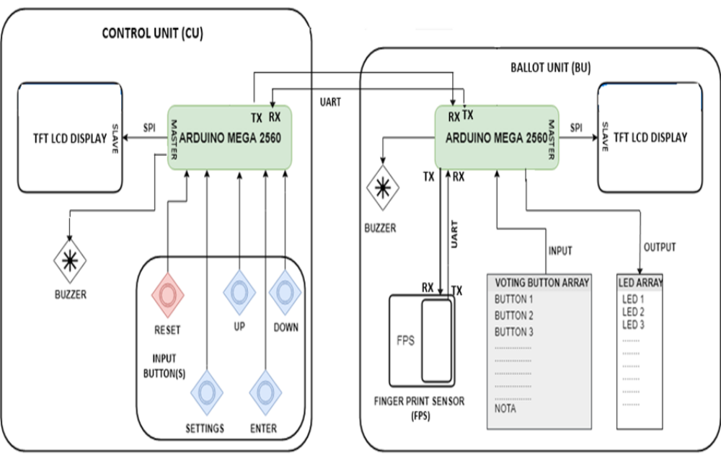
Existing System:

Slide 7
Proposed System:
In this project, an attempt has been made to the development of an authenticated electronic voting system using fingerprint and facial recognition.
The two-fold authentication system improves the security of the voting process and reduces the chances of a corrupt election process.
The facial recognition process utilizes the Local Binary Pattern Histogram and Support Vector Machine process to scan, store and recognize faces efficiently.
A private server (cloud or local) is used to store both the user data and the election results separately.
This reduces the chances of external manipulation of the election results.

Slide 8
Advantages:
Preserves voting secrecy, No scope for invalid votes
Highly tamper – proof.
Manpower required Less.
Avoids invalid voting as it prevents unregistered voters from voting.
Vote counting is digitalized so, counting process becomes lot more easier.

Slide 9
BLOCK DIAGRAM
ESP 8266
Power
supply
LCD DISPLAY
FINGER PRINT SENSOR
CAPACITIVE TOUCH PAD
RS232
CAMERA
PC

Slide 10
Hardware Requirements:
Power supply unit.
Fingerprint sensor.
ESP 8266.
RS 232.
16*2 LCD DISPLAY.
Capacitive touch pad.
Push buttons.
Led indication.

Slide 11
Software Requirements:
Mat lab 8.1
Platform - AVR STUDIO
In System Programmer - ProgISP 172
Compiler – Win AVR

Slide 12
Drawbacks:
Before voting the user has to enroll first.
Sensitivity of finger print module causes sometimes Combine character error.
Finger print recognition is that it is not affected by dryness or roughness of skin or by physical injury on surface of the hand but sometimes the temperature and humidity can affect the quality of the captured image

Slide 13
Result and Discussion:
The working of this model is very straightforward and very easy to understand.
First, the fingerprint reader scans the fingerprint of the voter and sends the output to the microcontroller.
The microcontroller then pairs the scanned data with the data in the database and retrieves the information about the voter.
The camera scans the face of the voter and checks whether it is similar to the face of the voter’s face data that is paired with the fingerprint.

Slide 14
Conclusion:
There are many fraudulent and illegal activities that are happening in regards to the current voting process.
With these problems in mind, the electronic voting machine is developed with fingerprint and facial recognition.
This dual authentication system reduces the chances of the above mentioned problems and so it has improves the security and efficiency of the voting process.

Slide 15
REFERENCES:
[1] Phillips, P., Grother, P., Micheals, R.J., Blackburn, D.M., Tabassi, E., Bone, J.M.: Face recognition vendor test 2002 results. Technical report (2003).
[2] Zhao, W., Chellappa, R., Rosenfeld, A., Phillips, P.J.: Face recognition: a literature survey. Technical Report CAR-TR-948, Center for Automation Research, University of Maryland (2002) Phillips, P.J., Wechsler, H., Huang, J., Rauss, P.: The FERET database and evaluation procedure for face recognition algorithms. Image and Vision Computing 16, 295–306 (1998).
[3] Turk, M., Pentland, A.: Eigenfaces for recognition. Journal of Cognitive Neuroscience 3, 71–86 (1991).
[4] Etemad, K., Chellappa, R.: Discriminant analysis for recognition of human face images. Journal of the Optical Society of America 14, 1724–1733 (1997).
[5] Moghaddam, B., Nastar, C., Pentland, A.: A bayesian similarity measure for direct image matching. In: 13th International Conference on Pattern Recognition, pp. II: 350–358 (1996).

Slide 16
REFERENCES:
[6] Ojala, T., Pietikäinen, M., Mäenpää, T.: Multiresolution gray-scale and rotation invariant texture classification with local binary patterns. IEEE Transactions on Pattern Analysis and Machine Intelligence 24, 971–987 (2002).
[7] Pantech, “Pantech unveils VEGA LTE-A, world's first LTE-A with fingerprint recognition and rear touch,” 2013.
[8] M. Bishop, Computer Security: Art and Science, Addison-Wesley, Boston, Mass, USA, 2003.
[9] N. K. Ratha, J. H. Connell, and R. M. Bolle, “Enhancing security and privacy in biometrics-based authentication systems,” IBM Systems Journal, vol. 40, no. 3, pp. 614–634, 2001.

Slide 17
Thank You

